Slide 1

PA3 GPU acceleration of electromagnetic simulation using finite-difference-time-domain (FDTD) method
Andy Varner, agkgd4
Notes:
I'm Andy. For PA3, i wanted to see if i could accelerate a really simple one dimensional implementation of the FDTD algorithm, which is used for electromagnetic simulations.

Slide 2
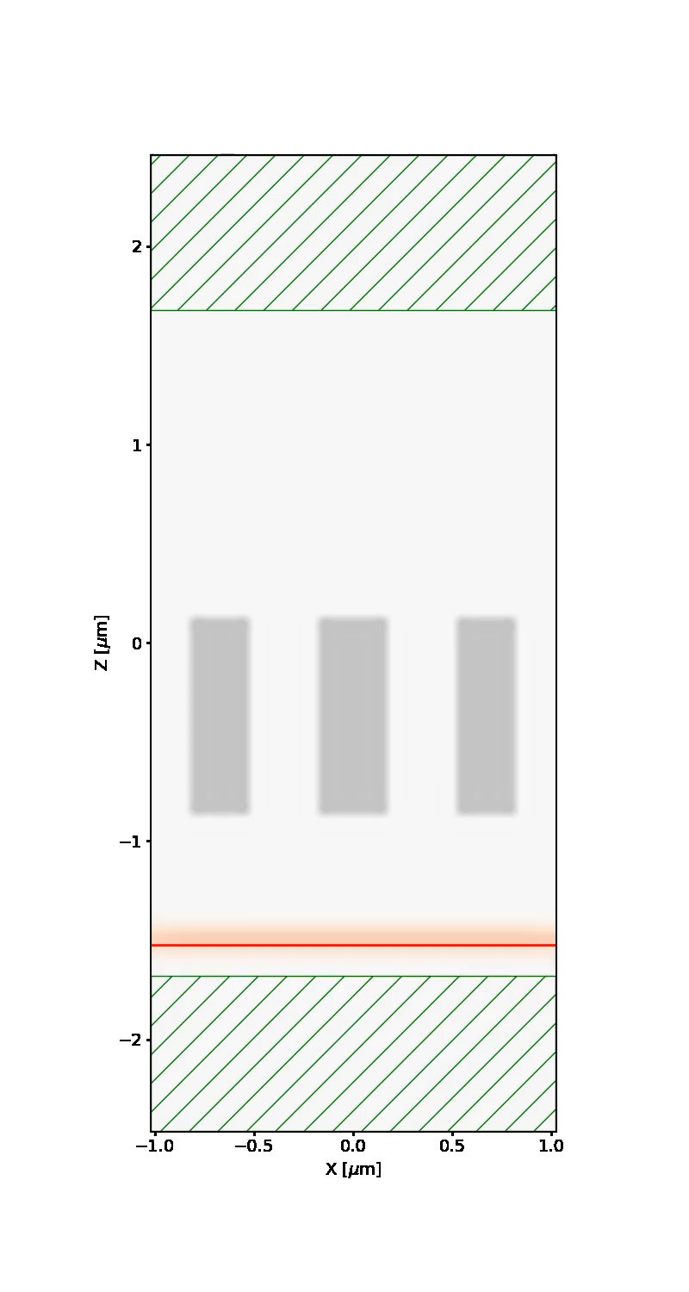
Building Data with Electromagnetic Simulations
2040 nm
PML
Electric Field Data
Requirements using meep:
15-30 minutes per simulation
32-48 cores
200 GB RAM
1020 nm
Metasurface
Unit Cells
Electromagnetic
Source
PML
Notes:
I use meep, which implements FDTD, to generate datasets for my research. Meep is not currently gpu accelerated, but it is cpu-accelerated. It takes 15-30 min to complete a simulation, depending on the quality of the resources, and I typically parallelize across 32-48 cores.

Slide 3
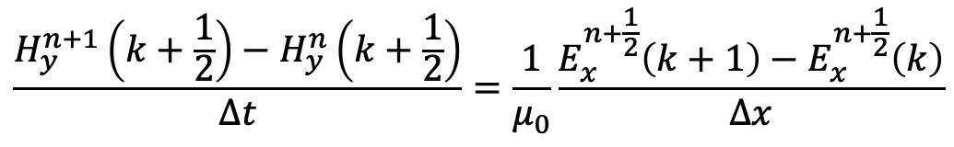
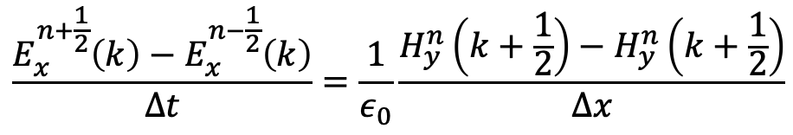
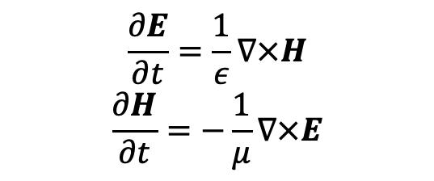


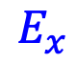
1D Finite Difference Time Domatin (FDTD) Method
Maxwell’s Equations
$$\frac{∂E}{∂t}=\frac{1}{ε}∇×H$$
$$\frac{∂H}{∂t}=−\frac{1}{μ}∇×E$$
$$E_{x}$$
Central Difference Approximation
$$H_{y}$$
$$z$$
$$\frac{E_{x}^{n+\frac{1}{2}}\left(k\right)−E_{x}^{n−\frac{1}{2}}\left(k\right)}{Δt}=\frac{1}{ε_{0}}\frac{H_{y}^{n}\left(k+\frac{1}{2}\right)−H_{y}^{n}\left(k+\frac{1}{2}\right)}{Δx}$$
$$\frac{H_{y}^{n+1}\left(k+\frac{1}{2}\right)−H_{y}^{n}\left(k+\frac{1}{2}\right)}{Δt}=\frac{1}{μ_{0}}\frac{E_{x}^{n+\frac{1}{2}}\left(k+1\right)−E_{x}^{n+\frac{1}{2}}\left(k\right)}{Δx}$$
Notes:
We have to start with Maxwell's equations, so the electric and magnetic field are interdependent, and they're governed by these spatial and temporal derivatives. Taking central difference approximations for these derivatives allows us to come up with an algorithm to solve these things. This approximation is for the one dimensional case, so you've got a wave propagating in z you're just going to get the x component of E and the y component of H

Slide 4








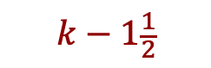
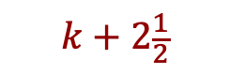
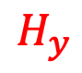


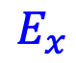



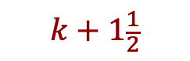



One Dimensional Maxwell’s Equations
Time units
Spatial Units
$$E_{x}^{n−1/2}$$
$$k−2$$
$$k−1$$
$$k$$
$$k+1$$
$$k+2$$
$$H_{y}^{n}$$
$$k−1\frac{1}{2}$$
$$k−\frac{1}{2}$$
$$k+\frac{1}{2}$$
$$k+1\frac{1}{2}$$
$$k+2\frac{1}{2}$$
$$E_{x}^{n+1/2}$$
$$k−2$$
$$k−1$$
$$k$$
$$k+1$$
$$k+2$$
$$E_{x}$$
$$H_{y}$$
$$z$$
Notes:
This slide just highlights again the interdependence of the electric and magnetic field - solving for some component of, say, the electric field is going to require the components of of the magnetic field at different points in space an time. So our problem is situated on top of all these grids, or arrays.

Slide 5
My implementation - Pseudocode
//Initialize electric field array
ex
//Initialize magnetic field array
hy
for step in range(1, num_steps+1):
// Calculate Ex
for k in range(1, spatial_size):
ex[k] = ex[k] + 0.5 * (hy[k - 1] - hy[k])
// Introduce Gaussian pulse in center
pulse = exp(-0.5 * ((t0 - time_step) / spread) ** 2)
ex[kc] = pulse
// Calculate Hy
for k in range(spatial_size - 1):
hy[k] = hy[k] + 0.5 * (ex[k] - ex[k + 1])
Notes:
So here'my cpu implementation of this algorithm. The electromagnetics is extermely simple - we're propagating in free space, we have perfectly conducting boundaries, a hard source, this is just a proof of concept. Notice we have two for loops inside of a for loop - for each time step, we'll solve for the x component of E and the y component of H.
T0 is the time index at which the pulse is introduced, 0.5 is courant factor (stability)

Slide 6
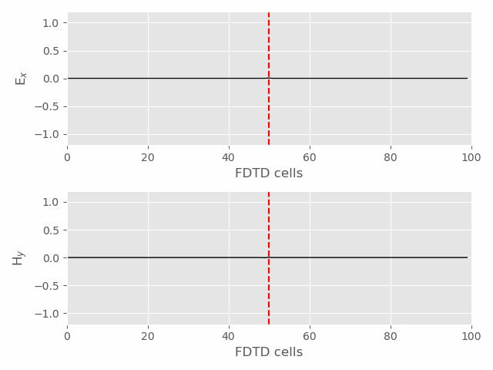

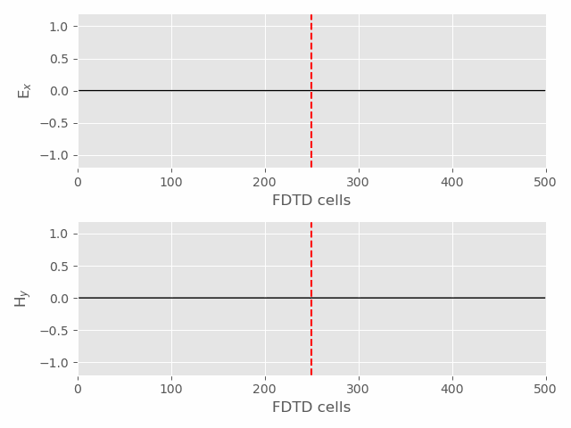
My Implementation – CPU Animations
Notes:
I went ahead and made some animations to make it clear what we're simulating. Just a Gaussian source originating in the center of the grid for some defined spatial extent. I run the simulation for the number of time steps equal to the spatial extent to make sure I propagate to the boundary.

Slide 7

The Experiment
CPU vs GPU
Spatial Extent == Time Step
100 300 500 700 1000 1500 2000
3000 5000 7500 10000 15000 20000 30000 50000 75000 100000 1000000
Values Tested
Notes:
And then for the experiment, I just increased my spatial extent and updated time steps accordingly so the complexity would scale. I tested values from spatial extent of 100 all the way up to one million.

Slide 8
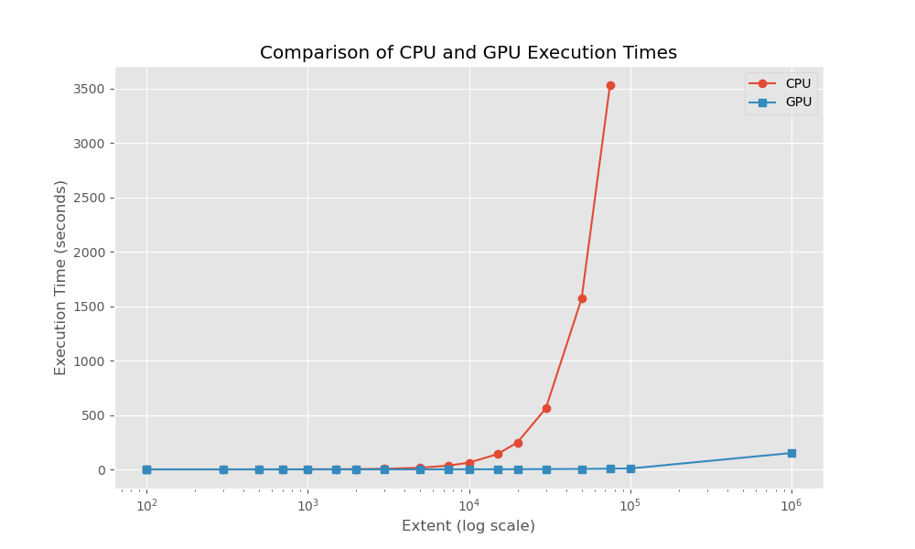
Results
Notes:
Sure enough, when we get to a certain level of complexity, the cpu starts to get really really slow and we see the benefits of gpu acceleration here. I didn't even run the cpu sim for the one million mark because it would've taken 5 hours, but it only took 2.5 minutes on the gpu program.

Slide 9
Discussion
//Initialize electric field array
ex
//Initialize magnetic field array
hy
for step in range(1, num_steps+1):
// Calculate Ex
for k in range(1, spatial_size):
ex[k] = ex[k] + 0.5 * (hy[k - 1] - hy[k])
// Introduce Gaussian pulse in center
pulse = exp(-0.5 * ((t0 - time_step) / spread) ** 2)
ex[kc] = pulse
// Calculate Hy
for k in range(spatial_size - 1):
hy[k] = hy[k] + 0.5 * (ex[k] - ex[k + 1])
CuPy is pretty easy to use!
Needed to update the algorithm a bit though.
Will this scale to more complicated FDTD implementations?
Notes:
Talk about array slicing versus for loops for using cupy.

